Slide 1

Introduction To Object-Oriented Programming
Chapter 5 – if Statements

Slide 2
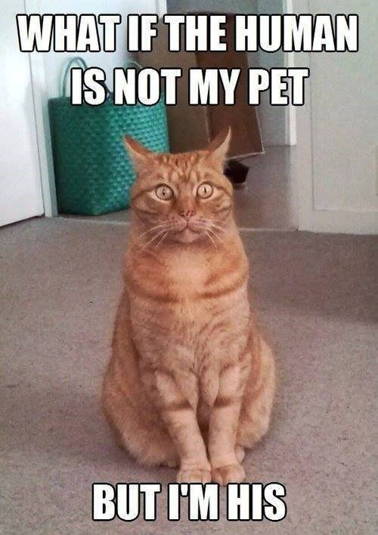
If Statements
Programming often involves examining a set of conditions and deciding which action to take based on those conditions.
Python’s if statement allows you to examine the current state of a program and respond appropriately to that state

Slide 3
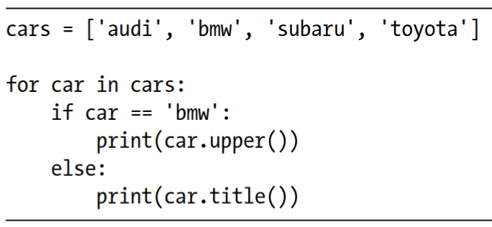
A Simple Example
Imagine you have a list of cars and you want to print out the name of each car. Car names are proper names, so the names of most cars should be printed in title case.
However, the value 'bmw' should be printed in all uppercase. The following code loops through a list of car names and looks for the value 'bmw'. Whenever the value is 'bmw', it’s printed in upper- case instead of title case.

Slide 4
Conditional Tests
At the heart of every if statement is an expression that can be evaluated as True or False and is called a conditional test. Python uses the values True and False to decide whether the code in an if statement should be executed.
If a conditional test evaluates to True, Python executes the code following the if statement.
If the test evaluates to False, Python ignores the code following the if statement.

Slide 5

Checking for Equality
Most conditional tests compare the current value of a variable to a specific value of interest. The simplest conditional test checks whether the value of a variable is equal to the value of interest
The first line sets the value of car to 'bmw' using a single equal sign, as you’ve seen many times already. The next line checks whether the value of car is 'bmw' by using a double equal sign (==). This equality operator returns True if the values on the left and right side of the operator match, and False if they don’t match.

Slide 6
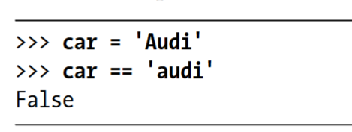
Ignoring Case When Checking for Equality
Testing for equality is case sensitive in Python. For example, two values with different capitalization are not considered equal:

Slide 7
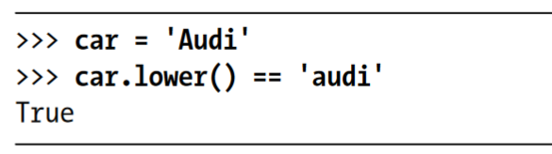
Ignoring Case When Checking for Equality
If case matters, this behavior is advantageous. But if case doesn’t matter and instead you just want to test the value of a variable, you can convert the variable’s value to lowercase before doing the comparison

Slide 8
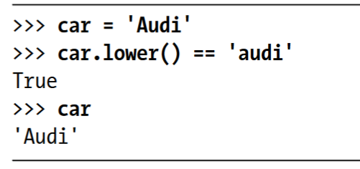
Ignoring Case When Checking for Equality
The lower() method doesn’t change the value that was originally stored in car, so you can do this kind of comparison without affecting the original variable

Slide 9
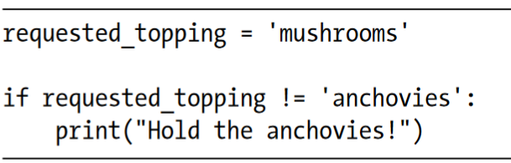
Checking for Inequality
When you want to determine whether two values are not equal, you can use the inequality operator (!=). Let’s use another if statement to examine how to use the inequality operator.

Slide 10
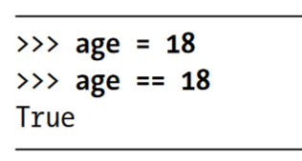
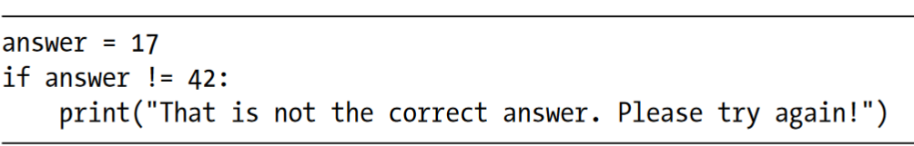
Numerical Comparisons
Testing numerical values is pretty straightforward. For example, the following code checks whether a person is 18 years old.
You can also test to see if two numbers are not equal. For example, the following code prints a message if the given answer is not correct

Slide 11
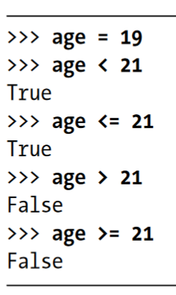
Numerical Comparisons
You can include various mathematical comparisons in your conditional statements as well, such as less than, less than or equal to, greater than, and greater than or equal to

Slide 12
Boolean Expression
As you learn more about programming, you’ll hear the term Boolean expression at some point.
A Boolean expression is just another name for a conditional test.
A Boolean value is either True or False, just like the value of a conditional expression after it has been evaluated.
Boolean values are often used to keep track of certain conditions, such as whether a game is running or whether a user can edit certain content on a website

Slide 13
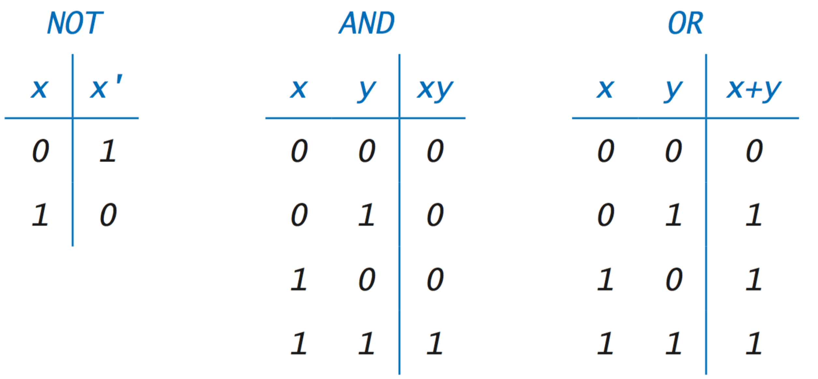
Checking Multiple Conditions
You may want to check multiple conditions at the same time. For example, sometimes you might need two conditions to be True to take an action. Other times, you might be satisfied with just one condition being True.
The keywords and and or can help you in these situations

Slide 14
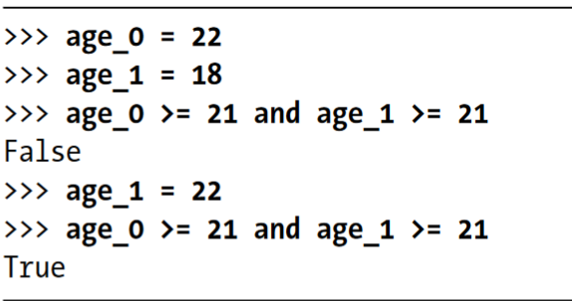
Checking Multiple Conditions
To check whether two conditions are both True simultaneously, use the keyword and to combine the two conditional tests
If each test passes, the overall expression evaluates to True.
If either test fails or if both tests fail, the expression evaluates to False.

Slide 15
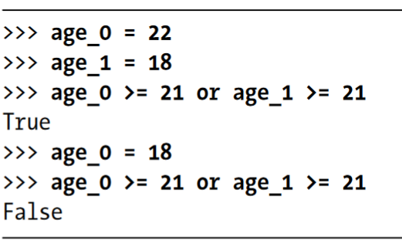
Checking Multiple Conditions
The keyword or allows you to check multiple conditions as well, but it passes when either or both of the individual tests pass.
An or expression fails only when both individual tests fail.

Slide 16
Truth Table

Slide 17
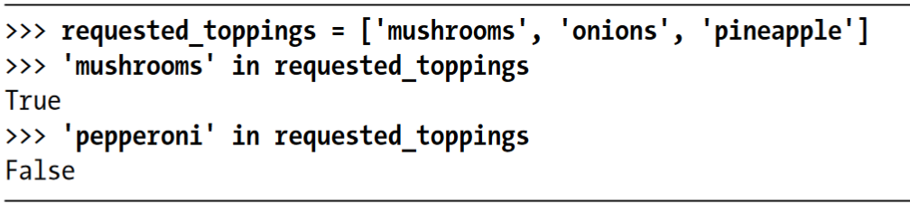
Checking Whether a Value Is in a List
Sometimes it’s important to check whether a list contains a certain value before taking an action. For example, you might want to check whether a new username already exists in a list of current usernames before completing someone’s registration on a website.
To find out whether a particular value is already in a list, use the keyword in

Slide 18
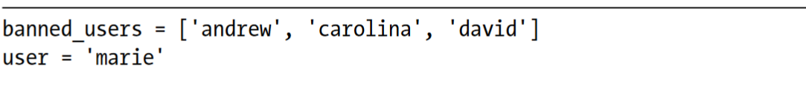
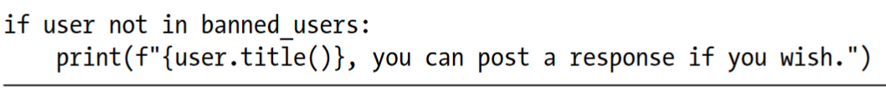
Checking Whether a Value Is Not in a List
Other times, it’s important to know if a value does not appear in a list. You can use the keyword not in this situation.

Slide 19
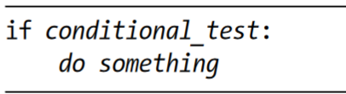
if Statements
When you understand conditional tests, you can start writing if statements.
Several different kinds of if statements exist, and your choice of which to use depends on the number of conditions you need to test.
The simplest kind of if statement has one test and one action

Slide 20
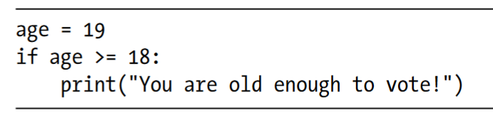
if Statements
If the conditional test evaluates to True, Python executes the code following the if statement. If the test evaluates to False, Python ignores the code following the if statement

Slide 21
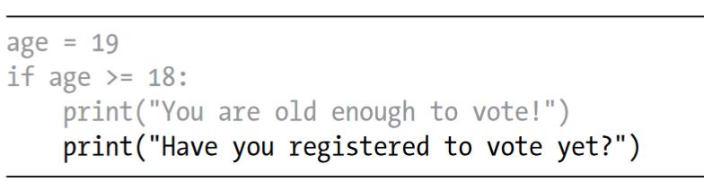
if Statements
Indentation plays the same role in if statements as it did in for loops. All indented lines after an if statement will be executed if the test passes, and the entire block of indented lines will be ignored if the test does not pass. You can have as many lines of code as you want in the block following the if statement.

Slide 22
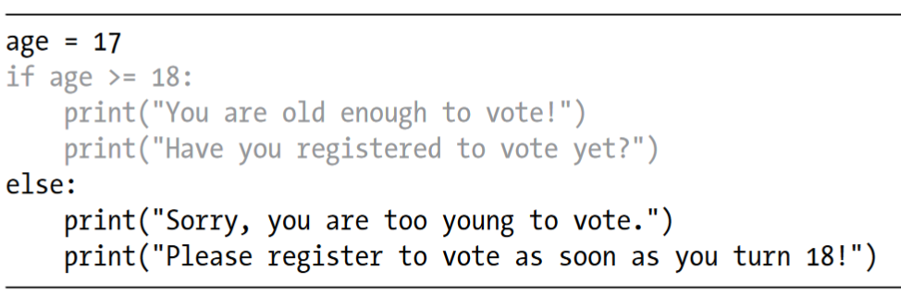
if-else Statements
Often, you’ll want to take one action when a conditional test passes and a different action in all other cases. Python’s if-else syntax makes this possible.
An if-else block is similar to a simple if statement, but the else statement allows you to define an action or set of actions that are executed when the conditional test fails.

Slide 23
The if-elif-else Chain
Often, you’ll need to test more than two possible situations, and to evaluate these you can use Python’s if-elif-else syntax. Python executes only one block in an if-elif-else chain. It runs each conditional test in order, until one passes.
When a test passes, the code following that test is executed and Python skips the rest of the tests

Slide 24
The if-elif-else Chain
For example, consider an amusement park that charges different rates for different age groups:
Admission for anyone under age 4 is free.
Admission for anyone between the ages of 4 and 18 is $25.
Admission for anyone age 18 or older is $40.
How can we use an if statement to determine a person’s admission rate?

Slide 25
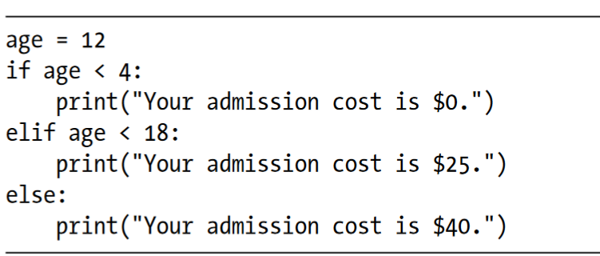
The if-elif-else Chain

Slide 26
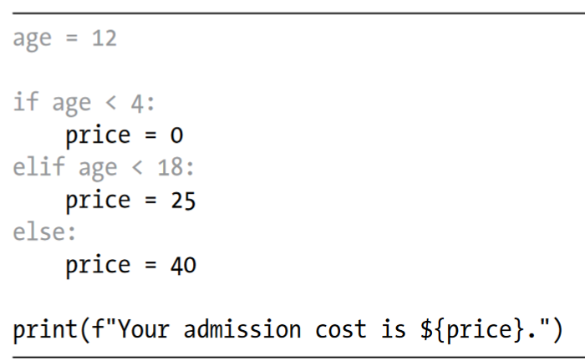
The if-elif-else Chain
Rather than printing the admission price within the if-elif-else block, it would be more concise to set just the price inside the if-elif-else chain and then have a single print() call that runs after the chain has been evaluated:

Slide 27
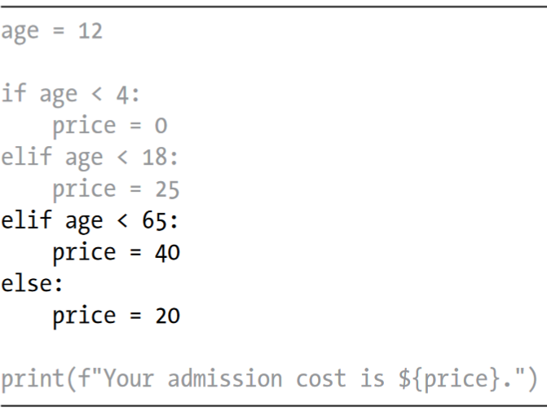
Using Multiple elif Blocks
You can use as many elif blocks in your code as you like.
For example, if the amusement park were to implement a discount for seniors, you could add one more conditional test to the code to determine whether someone qualifies for the senior discount. Let’s say that anyone 65 or older pays half the regular admission, or $20

Slide 28
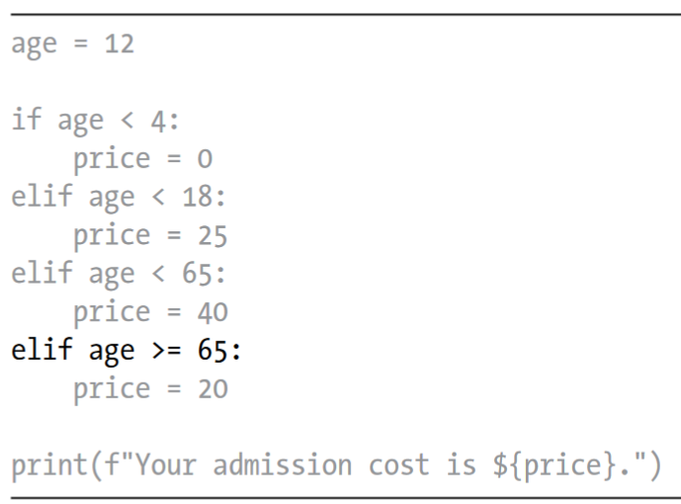
Omitting the else Block
Python does not require an else block at the end of an if-elif chain.
Sometimes, an else block is useful. Other times, it’s clearer to use an additional elif statement that catches the specific condition of interest

Slide 29
Testing Multiple Conditions
The if-elif-else chain is powerful, but it’s only appropriate to use when you just need one test to pass. As soon as Python finds one test that passes, it skips the rest of the tests. This behavior is beneficial, because it’s efficient and allows you to test for one specific condition.
However, sometimes it’s important to check all conditions of interest. In this case, you should use a series of simple if statements with no elif or else blocks. This technique makes sense when more than one condition could be True, and you want to act on every condition that is True.

Slide 30
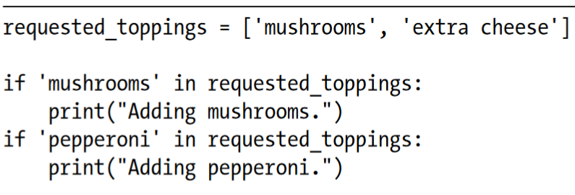
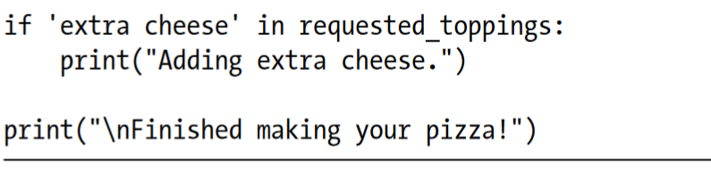
Testing Multiple Conditions
Let’s reconsider the pizzeria example. If someone requests a two-topping pizza, you’ll need to be sure to include both toppings on their pizza

Slide 31
Testing Multiple Conditions
In summary, if you want only one block of code to run, use an if-elif-else chain.
If more than one block of code needs to run, use a series of independent if statements.

Slide 32
Using if Statements with Lists
You can do some interesting work when you combine lists and if statements.
You can watch for special values that need to be treated differently than other values in the list.
You can efficiently manage changing conditions, such as the availability of certain items in a restaurant throughout a shift.
You can also begin to prove that your code works as you expect it to in all possible situations.

Slide 33
Using if Statements with Lists
You can do some interesting work when you combine lists and if statements.
You can watch for special values that need to be treated differently than other values in the list.
You can efficiently manage changing conditions, such as the availability of certain items in a restaurant throughout a shift.
You can also begin to prove that your code works as you expect it to in all possible situations.

Slide 34
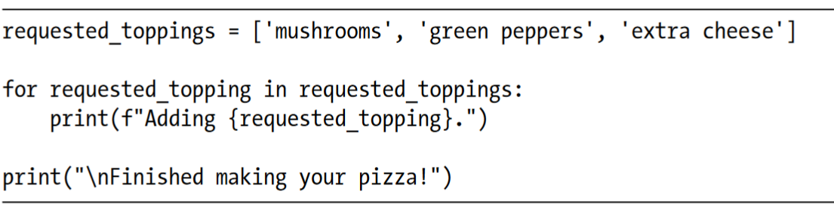
Checking for Special Items
Let’s continue with the pizzeria example. The pizzeria displays a message whenever a topping is added to your pizza, as it’s being made. The code for this action can be written very efficiently by making a list of toppings the customer has requested and using a loop to announce each topping as it’s added to the pizza

Slide 35
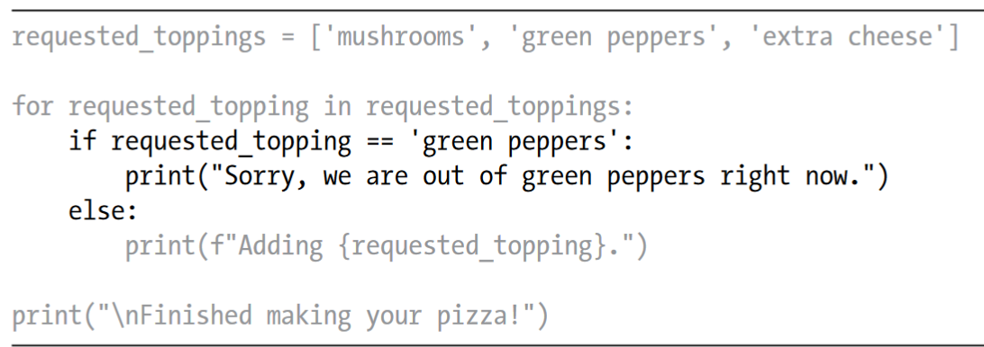
Checking for Special Items
But what if the pizzeria runs out of green peppers? An if statement inside the for loop can handle this situation appropriately:

Slide 36
Checking That a List Is Not Empty
We’ve made a simple assumption about every list we’ve worked with so far: we’ve assumed that each list has at least one item in it.
As an example, let’s check whether the list of requested toppings is empty before building the pizza. If the list is empty, we’ll prompt the user and make sure they want a plain pizza. If the list is not empty, we’ll build the pizza just as we did in the previous examples.

Slide 37
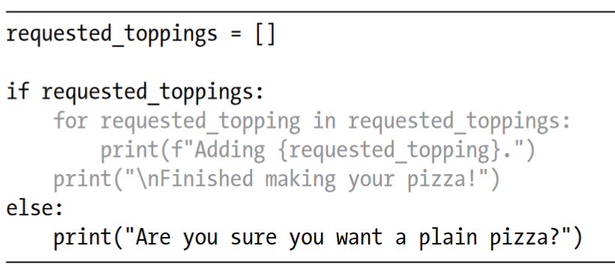
Checking That a List Is Not Empty
This time we start out with an empty list of requested toppings. Instead of jumping right into a for loop, we do a quick check first.
When the name of a list is used in an if statement, Python returns True if the list contains at least one item; an empty list evaluates to False. If requested_toppings passes the conditional test, we run the same for loop we used in the previous

Slide 38
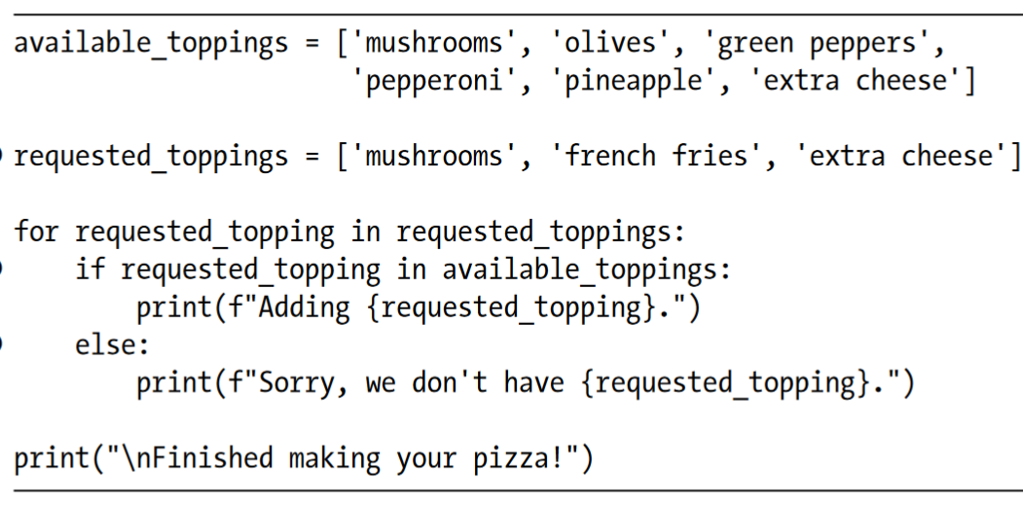
Using Multiple Lists
People will ask for just about anything, especially when it comes to pizza toppings. What if a customer actually wants french fries on their pizza? You can use lists and if statements to make sure your input makes sense before you act on it.

Slide 39
Summary
In this chapter you learned how to write conditional tests, which always evaluate to True or False.
You learned to write simple if statements, if-else chains, and if-elif-else chains.
You began using these structures to identify particular conditions you need to test and to know when those conditions have been met in your programs.
You learned to handle certain items in a list differently than all other items while continuing to utilize the efficiency of a for loop.

